Slide 1
Time series
Siva

Slide 2
Regression – Sales estimation
Consider sales in the past two weeks as 100, 100 100
The sales during Wk5 and Wk6 can be easily guessed as 100 and 100.
Wk1 | Wk2 | Wk3 | Wk4 | Wk5 | Wk6
100 | 100 | 100 | 100 | ? | ?
Wk1 | Wk2 | Wk3 | Wk4 | Wk5 | Wk6
100 | 100 | 100 | 100 | 100 | 100

Slide 3
Math preliminaries
Consider the sales slightly perturbed as follows.
The sales during Wk5 and Wk6 can still be easily guessed as 100,and 100.
Wk1 | Wk2 | Wk3 | Wk4 | Wk5 | Wk6
102 | 98 | 105 | 95 | ? | ?
Wk1 | Wk2 | Wk3 | Wk4 | Wk5 | Wk6
102 | 98 | 105 | 95 | 100 | 100

Slide 4
Math preliminaries
Consider the sales with a trend as follows.
The sales during Wk5 and Wk6 can be easily guessed as 500 and 600.
Again with slightly perturbed data, we can still predict the sales.
Wk1 | Wk2 | Wk3 | Wk4 | Wk5 | Wk6
100 | 200 | 300 | 400 | ? | ?
Wk1 | Wk2 | Wk3 | Wk4 | Wk5 | Wk6
100 | 200 | 300 | 400 | 500 | 600
Wk1 | Wk2 | Wk3 | Wk4 | Wk5 | Wk6
110 | 190 | 315 | 385 | 500 | 600

Slide 5
Math preliminaries
Consider the sales with a trend and some fixed number as follows.
The sales during Wk5 and Wk6 can be easily guessed as 500 and 600.
Again with slightly perturbed data, we can still predict the sales.
Wk1 | Wk2 | Wk3 | Wk4 | Wk5 | Wk6
150 | 250 | 350 | 450 | ? | ?
Wk1 | Wk2 | Wk3 | Wk4 | Wk5 | Wk6
150 | 250 | 350 | 450 | 550 | 650
Wk1 | Wk2 | Wk3 | Wk4 | Wk5 | Wk6
148 | 253 | 345 | 455 | 548 | 652

Slide 6
Seasonal
Consider the sales with the following pattern.
We could observe certain seasonal pattern.
Again with slightly perturbed data, we can still predict the sales.
Wk1 | Wk2 | Wk3 | Wk4 | Wk5 | Wk6 | wk7 | wk8
100 | 200 | 100 | 100 | 100 | 200 | 100 | 100
Wk1 | Wk2 | Wk3 | Wk4 | Wk5 | Wk6 | wk7 | wk8
102 | 205 | 97 | 103 | 101 | 196 | 102 | 98

Slide 7
Forecast and prediction
These type of predictions or forecasts we come across quite often.
We saw three patterns.
Trend,
Seasonal
Some random differences but limited maginitude.
All these ideas led to the fields known as
‘Time series analysis’, ‘Demand forecasting’ etc., etc.,
There is a difference between prediction and forecasting

Slide 8
Time series – basic concepts
A time series is a set of statistics, usually collected at regular intervals.
Time series data occur naturally in many application areas.
Economics - e.g., monthly data for unemployment, hospital admissions, etc.
Finance - e.g., daily exchange rate, a share price, etc.
environmental - e.g., daily rainfall, air quality readings.
medicine - e.g., ECG brain wave activity every 2−8 secs
One simple method of describing a series is that of classical decomposition.
The notion is that the series can be decomposed into four elements:
Trend (Tt) — long term movements in the mean;
Seasonal effects (It) —
cyclical fluctuations related to the calendar;
Cycles (Ct) — other cyclical fluctuations (such as a business cycles);
Residuals (Et) — other random or systematic fluctuations.
The idea is to create separate models for these four elements and then combine them,
either additively Xt = Tt + It + Ct + Et
or multiplicatively Xt = Tt · It · Ct · Et .

Slide 9
Stages in computing the forecasts
Outlier filtering: Elimination or correcting the values of some observations if the observed values are not in the acceptable range.
Methods will be presented for outlier filtering.
Missing data:
When there are some missing data, computing the forecast.
Methods for computing the forecast
Time series methods,
Regression methods,
Expert opinion (Delphi) and customer survey methods
We will be considering the first two here.
Mathematically,
If X(1), X(2),…,X(i) are the demands (sales orders )in the past, then
X(i+1) = f(X(i), X(i-1), X(i-2),…).
Ofcourse, there will be small random fluctuations even under normal conditions which can be described as error between the actual value and the predicted value based on the past.
Thus, x(i+1) = f(x(i), x(i-1),…, n(i), n(i-1),…..)
That error is known as the ‘noise’ in the forecasting literature.
Our methods should be able to predict the forecasts by minimizing the effect of the ‘noise’ .
Once the function f(X) is determined, the forecasts can be computed.

Slide 10
Time series Methods
Mathematically,
If X(1), X(2),…,X(i) are the demands (sales orders )in the past, then
X(i+1) = f(X(i), X(i-1), X(i-2),…).
Ofcourse, there will be small random fluctuations even under normal conditions which can be described as error between the actual value and the predicted value based on the past.
Thus, x(i+1) = f(x(i), x(i-1),…, n(i), n(i-1),…..)
That error is known as the ‘noise’ in the forecasting literature.
Our methods should be able to predict the forecasts by minimizing the effect of
the ‘noise’ .
Once the function f(X) is determined, the forecasts can be computed.

Slide 11
Regression
However some events can drive the demand for a product. E.g., Promotional activities, advertisement etc.
In such cases ,
x(i+1) = f(x(i),x(i-1),…, n(i),n(i-1),…, u(i),u(i-1),..) where u(i) denotes investment or the efforts made to boost up the demand.
These terms (u(i)) are named as ‘Causals’.

Slide 12
Topics to be covered
Topics to be presented in this sub-chapter will be
Moving average of the past (sales) data.
Weighted moving average.
The weightage can be exponential
Single, Double and Triple Exponential smoothing with simple derivations of the formulas
Theory of ARMA models: Box Jenkins(Detailed)
Single and Multiple Regression (detailed)
Crostons
Pick best
These are the methods used in the following commercial software for supply chain management and optimization.
i) Demand Manager of i2 Technologies
Ii)SAP APO Demand Planner
Iii)Oracle SCM tool box

Slide 13
Time series - Moving Average
What is Time series estimation
Given the past data x(t), x(t-1), x(t-2),….etc., estimate x(t+1), x(t+2), .
Ex: x(t) can represent actual sales data in a particular zone.
However,
There can be some known and unknown events that could affect the values in the future.
Ex: Advertisements, promotions etc.,
If possible, those have to be taken into account.
These external factors are called ‘causals’
For the time being, assume there are no causals.

Slide 14
Moving average
So, in our case we assume that the demand is almost constant except for some slight fluctuations
X(t) = a + e(t) where ‘e’ denotes noise or error. ‘a’ is to be estimated. ‘a’ is known as smoothened value of the time series x(t).
In other words,
Given, actual sales data x(t), x(t-1, x(t-2),…, estimate the best value for x(t+1)
The first intutive idea is to take the average of some of the past measurements.
X(t+1) = (1/n) (x(t) + x(t-1) + ….+x(t-(n-1))
If n= 3 , it is 3 point average.
X(t+1) = (1/3)(x(t) + x(t-1) + x(t-2) )
What does this mean? What is the significance of the ‘average’?

Slide 15
Least squares
Least squares Let x^(t+1) be the best estimate for x(t+1)
The estimate x^(t+1) is to be as close as possible to all the ‘n’ values.
If n =3 then
➔the sum of the (squares) of the differences has to be minimum.
➔ Minimise (x^(t+1) - x(t))² + (x^(t+1) - x(t-1))² + (x^(t+1) - x(t-2))² w.r.t x^(t+1) .
➔(d/d x^(t+1) ) {(x^(t+1) - x(t))² + (x^(t+1) - x(t-1))² + (x^(t+1) - x(t-2))² = 0;
➔2{(x^(t+1) - x(t)) + (x^(t+1) - x(t-1)) + (x^(t+1) - x(t-2)) = 0
➔ x^(t+1) = (1/3){ x(t) + x(t-1) + x(t-2)}

Slide 16
The weightage
Sometimes, we give different importance to the different data along the time line. In that case, the objective is to minimize
W1 *(x^(t+1) - x(t))² +
W2 * (x^(t+1) - x(t-1))² +
W3 * (x^(t+1) - x(t-2))²
w.r.t x^(t+1) where W1,W2 and W3 >= 0.
We can assume W1 + W2 + W3 = 1 w.l.g
In this case,
x^(t+1) = W1 x(t) + W2 x(t-1) + W3 x(t-2)
This is nothing but the so called ‘weighted average’ !
Remember the result
If the weighting coefficients sum up to unity, then the weighted sum is the ‘best estimate’ with respect to the least squares measure.

Slide 17
Exponential smoothing
If we want continuous improvement,
if we want the entire past to be taken into account, ofcourse, the weightage is to be diminishing along the past
How to frame the objective?
Remember the objective function given before.
Minimize W1 *(x^(t+1) - x(t))² +
W2 * (x^(t+1) - x(t-1))² +
W3 * (x^(t+1) - x(t-2))²
If we extend to the infinite past, it is
Minimize
W1 *(x^(t+1) - x(t))² + W2 * (x^(t+1) - x(t-1))² + ….+
W(k) * (x^(t+1) - x(t-(k-1)))^{2 + ….}
Choose W(i) as 1,1-α, (1-α)², (1-α)³,…, (1-α)^{k} ,… where α > 0 and α < 1;
Ex: If α = .5, the weighing coefficients will be
1, .5, .25, .125,……. → 0
The objective will be
(x^(t+1) - x(t))² +(1- α) * (x^(t+1) - x(t-1))² + ….+
(1- α)^{k} * (x^(t+1) - x(t-(k-1)))^{2 + ….}

Slide 18
Computations
Just to make the sum of the weighing coefficients to 1, we can multiply the whole expression by α.
In this case ,
( α) (1 +(1-α) + (1-α)² + (1-α)³ … + (1-α)^{k} + …….) = 1.
By taking the derivative and making it 0,
We get, x^(t+1) = ( α) { x(t) +(1-α) x(t-1) + (1-α)² x(t-2) + (1-α)³ x(t-3) … +(1- α)^{k} x(t-k) + …….)
= ( α) { x(t) + (1-α ) ( x(t-1) + (1-α) x(t-2) + …. }
= α x(t) + α (1-α ) {x^(t) / α}
= α x(t) + (1-α ) x^(t)
This is the popular formula for single exponential smoothing. Weighted avarage of the prev value and the forecast.
Or
Prev forecast + Weightage * Error (Called ‘Gradient search’ in optimization literature.
The formulas agree with our intuition.
Next, the Trend

Slide 19
Trend – Double exponential smoothing
In many business examples, there will be a steady raise in the sales or decline.
This will be compounded by the error we mentioned before.
In this situation, double exponential smoothing helps!
sales
nT

Slide 20
Double exponential smoothing
The process can be described as
X(t+1) = x(t) + (b(t) + et(t) ) + e(t)
Second term is the trend component. It is nothing but the difference between 2 adjacent values.
This is also to be estimated from the past data and continuously improved.
x^(t+1) = α x(t) + (1- α) {x^(t) + b(t) }
b(t) = ß (x^(t+1) - x^(t) ) + ( 1 – ß) b(t-1)
The first term in the expression for b(t) is the smoothed trend instead of taking trend based on the actual measurements.

Slide 21
The first smoothing equation adjusts x^(t) directly for the trend of the previous period, b(t) , by adding it to the last smoothed value, x^(t) . This helps to eliminate the lag and brings x^(t) to the appropriate base of the current value.
The second smoothing equation then updates the trend, which is expressed as the difference between the last two values. The equation is similar to the basic form of single smoothing, but here applied to the updating of the trend.

Slide 22
Seasonality
3.4.1 Holt-Winter's Method, Multiplicative Seasonality
The equations:
Seasonality coefficient is defined by
The value at a given time interval / Average of the values for one full cycle.
If the cycle contains 4 periods, then Seasonality coefficient at a given period is given by
S_{t} = y_{t} / { (y_{t} + y_{t-1} + y_{t-2} + y_{t-3} )/4 }

Slide 23
Data with trend and seasonality
Sales &Fcst
Time periods

Slide 24
Holt Winter procedure
Triple exponential method
This method is used if there are both trend and seasonality in the data.
There are explicit formulas to compute the forecasts when there are trend and seasonality.
A heuristic formula:
The data is to be approximated by
K * T * * (i) * S(j)
where ‘T’is the trend and S(j) denotes the seasonality.
T > 1 if the quantity is going up and < 1 the other way round.
1 <= j <= 12.

Slide 25
The workflow in demand planning process
Demand planning process is to compute the quantity of different products to be produced and distributed.
Forecasting is only a sub process.
Forecasts are always wrong. Hence adjustment is a natural process.
Demands are planned for ‘products’. Everyday, there are new products added to the business and removed. Also, many products are moved among different hierarchies.
Forecast is done at optimal level in the hierarchies. Lower levels are prone to errors and higher levels are not useful for planning. Hence a mid level is chosen for forecasting.
Aggregation is to be used for finding the demands at higher levels and ‘dis aggregation’ for finding the demands at lower levels.

Slide 26
Considering all these points, we summarize
Plan the correct level in the hierarchy for forecasting.
Perform Product management and identify the position of a product, location combination based on the realignment data given.
Analyze the availability of history data depending on the model used. For a model with the trend and seasonality, 24 months of history is necessary for good forecasts.
Get the cleaned up history data by considering outliers. A simple formula is based on the difference with the yearly average.
Generate the stat forecasts and/or adjust for the final forecasts. The tools will calculate forecasts based on the procedures defined or ‘Pick best’.
Perform aggregation and/or disaggregation for the final data at required levels along the hierarchies.
Dis aggregation can be performed based on the ratios calculated from the past history or user defined.
Consensus forecasts is an extension of the ‘Pick best’ where forecasts based on human judgment are also taken into account.

Slide 27
Stochastic process in a nutshell
When a random event occurs at continuous periods of time, it is known as stochastic process.
A random variable is described by a probability distribution. In a stochastic process, if the probability is independent of values at other time instants, the process is independent and if the probabaility distribution is same at all instants the process is known as identical. Overall the process is i.i.d process.
Joint distribution:
If X and Y are random variables, then P(X=x,Y=y) for all x and y is defined as joint distribution.
Instead of Y we can consider X at another time instant and define joint distribution.
This can be defined for all pairs of time indices.

Slide 28
Stationarity
1)A sequence {Xt , t ∈ Z} is strongly stationary or strictly stationary if
(Xt1 , . . . , Xtk ) (=d) (Xt1+h, . . . , Xtk+h) for all sets of time points t1, . .
, tk and integer h.
2. A sequence is weakly stationary, or second order stationary if
(a) E(Xt) = µ, and
(b) cov(X(t) , X(t+k)) = γk, where µ is constant and γk is independent of t.
3. The sequence {γk, k ∈ Z} is called the autocovariance function.
4. We also define ρk = γk/γ0 = corr(Xt , X(t+k)) and call {ρk, k ∈ Z} the autocorrelation function (ACF).

Slide 29
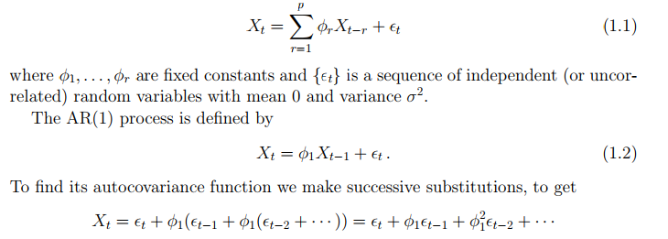
Auto regressive process
The autoregressive process of order p is denoted AR(p), and defined by

Slide 30
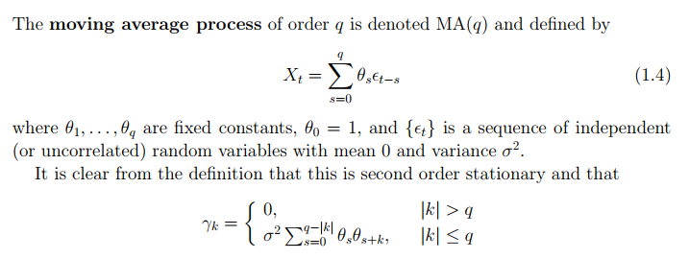
Moving average process

Slide 31
White noise
The sequence {ϵ(t)}, consisting of independent (or uncorrelated) random variables with mean 0 and variance σ² is called white noise (for reasons that will become clear later.)
It is a second order stationary series with γ(0 )= σ² and γ(k) = 0, k != 0.

Slide 32
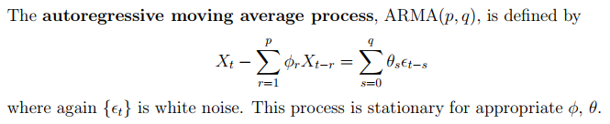
ARMA process
ARIMA process

Slide 33
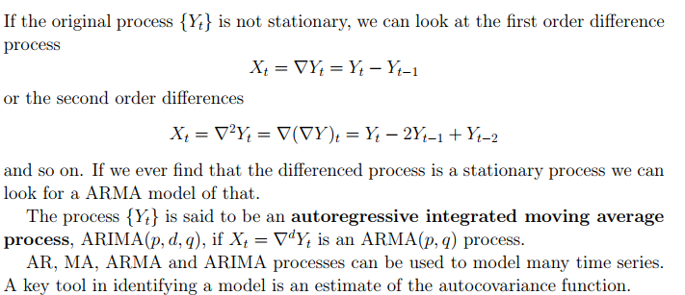

Slide 34
Intuition
Most of the processes are governed by 3 factors.
i) Inertia(Resistance to change) ii) Resistance iii) Spring effect or storage
Hence all these processes can be modeled by differential equations which can be approximated by difference expressions.
The difference expressions lead to the representation of future in terms of the past data.
In case there are multiple elements, the effect cascade and result in higher order difference expressions and hence more past samples.
X(k+1) = f(Xk, X(k-1), X(k-2),…..).
In most of the time series problems there is no explicit input that drives or generates the data.
Still there could be unknown. For example, in ECG, it is the pulses from Brain which activate.
Those inputs are modeled as fictitious and absorbed in the data itself.
Those energy sources are mostly eliminated by differencing in other words differentiation in continuous time.

Slide 35
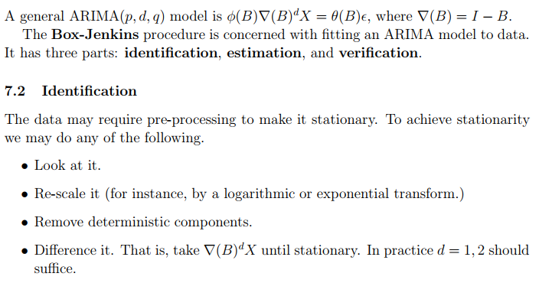
Unified Box Jenkins

Slide 36
Once the series is stationary, we can try to fit an ARMA(p, q) model. We consider the correlogram rk = ˆγk/γˆ0 and the partial autocorrelations φˆ k,k. We have already made the following observations. • An MA(q) process has negligible ACF after the qth term. • An AR(p) process has negligible PACF after the pth term. As we have noted, very approximately, both the sample ACF and PACF have standard deviation of around 1/ √ T, where T is the length of the series. A rule of thumb is that ACF and PACF values are negligible when they lie between ±2/ √ T. An ARMA(p, q) process has kth order sample ACF and PACF decaying geometrically for k > max(p, q).

Slide 37
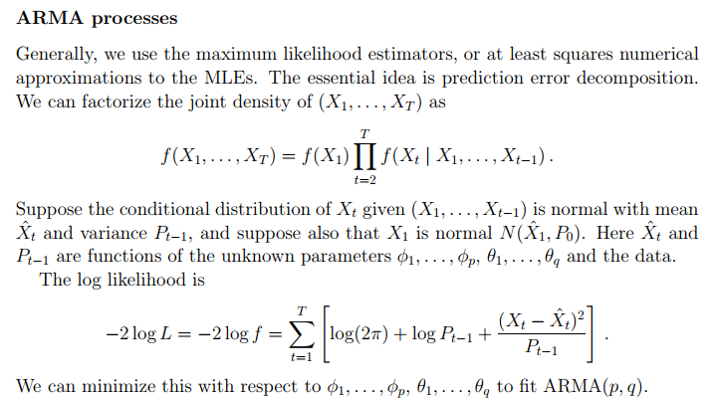

Slide 38
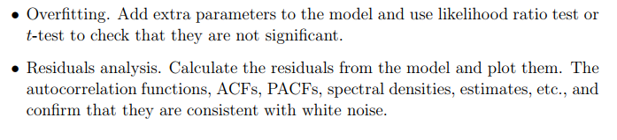

Slide 39
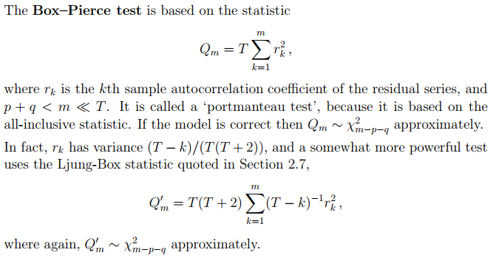

Slide 40
Examples and case studies

Slide 41
Math preliminaries
Take away:
By looking at the patterns, we are able to predict.
Case 1: It was found that x(t+1) = c0;
Case 2: x(t+1) = c0+ e;
Case 3: x(t+1) = c1 * t;
Case 4: x(t+1) = c1 *t + e;
Case 5: x(t+1) = c1 *t + c0 + e
Ultimately, we fit a ‘model’ to the observed data, leaving a side small fluctuating terms on both sides and predicted the outcomes based on the derived model.
These ideas are enhanced to fit suitable models for the observed data for making useful predictions!!!
These form the core of data science, machine learning, business analytics etc., etc.,

